Slide 1
Guided Reading Skills
Inference

Slide 2


Inference
What is Inference?
Inference is where we 'read between the lines' to gain a greater understanding of what we are looking at and to reach logical conclusions.

Slide 3
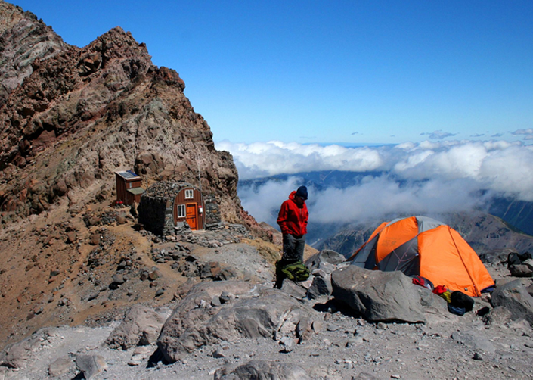
Inference
Who is in the picture?
Is it cold or hot in the mountains?
How does the mountaineer feel?
Why has the mountaineer chosen to climb to this location?
Photo courtesy of Andrew E. Larsen (@flickr.com) - granted under creative commons licence - attribution

Slide 4
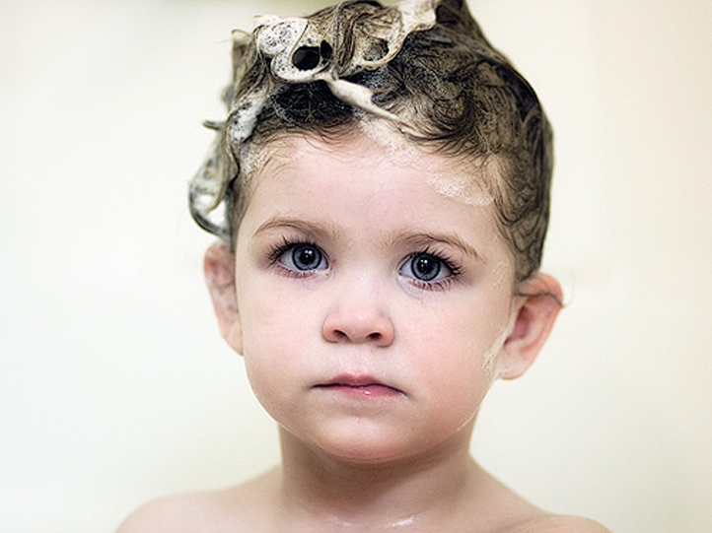
Inference
What is happening in this picture?
How does the child feel about it?
Why isn’t the child wearing a top?
Photo courtesy of thejbird (@flickr.com) - granted under creative commons licence - attribution

Slide 5
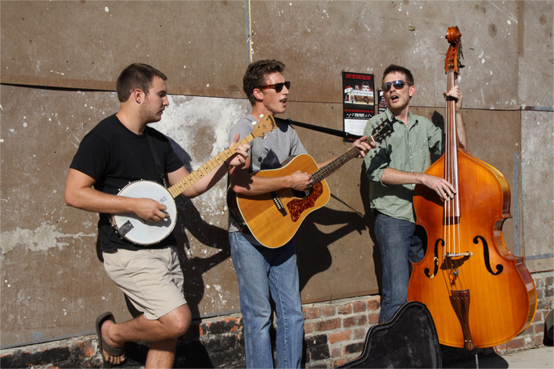
Inference
Why are these men playing instruments outside?
Why do two of the men have their mouths open?
How does playing music make them feel?
What sort of music are they playing?
Photo courtesy of Gamma Man (@flickr.com) - granted under creative commons licence - attribution

Slide 6
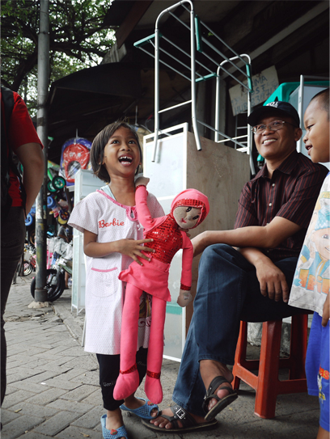
Inference
What is the girl looking at?
How does she feel about what she can see?
What is the weather like where the girl is?
Photo courtesy of nSeika (@flickr.com) - granted under creative commons licence - attribution

Slide 7
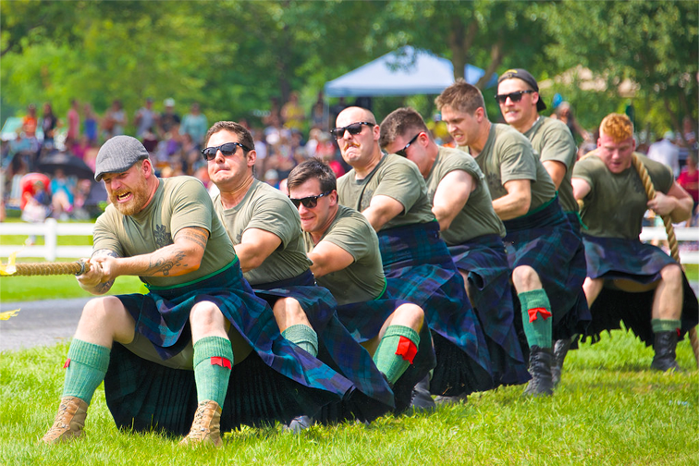
Inference
What is happening here?
How can you tell that the men are putting in a lot of effort?
Why does the man at the back only have one hand on the rope?
How can you tell that these men belong to a club or group?
What is the weather like?
Photo courtesy of Jamie McCaffrey (@flickr.com) - granted under creative commons licence - attribution

Slide 8
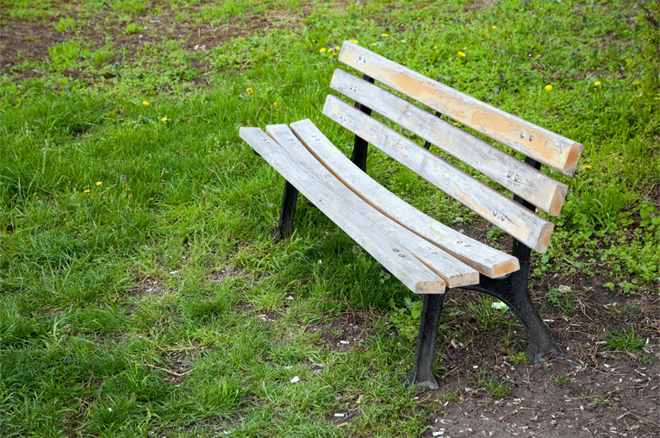
Inference
Where is this bench?
Who sits on it?
Is this bench new or old?
Does this bench look comfortable?
Photo courtesy of Horia Varlan (@flickr.com) - granted under creative commons licence - attribution

Slide 9
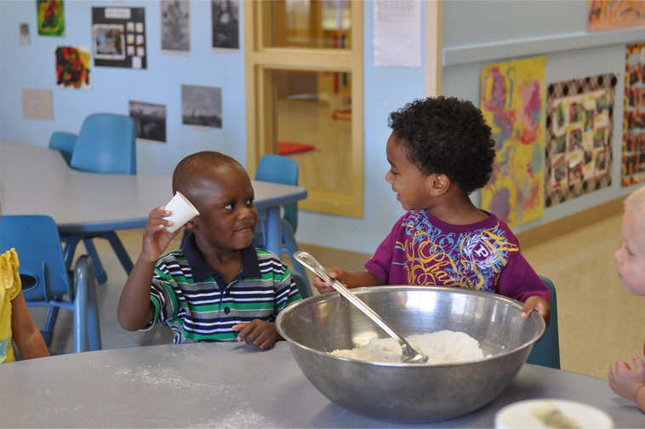
Inference
What are these children doing?
Where are they?
How do they feel about what they are doing?
What are they going to do next?
Do these children know each other?
Photo courtesy of familymwr (@flickr.com) - granted under creative commons licence - attribution

Slide 10
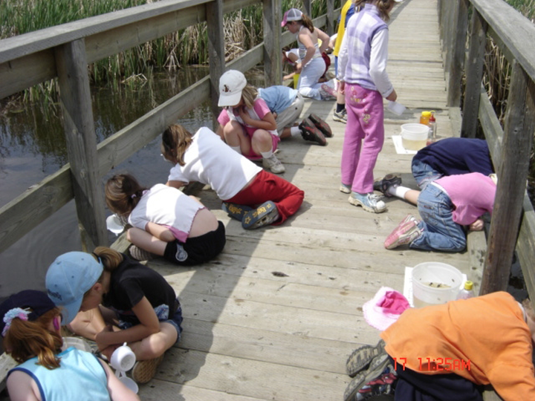
Inference
Why are these children on the floor?
What are they looking at?
Why are they wearing hats?
Why do you think they are on a bridge?
Photo courtesy of Kathy Cassidy (@flickr.com) - granted under creative commons licence - attribution

Slide 11
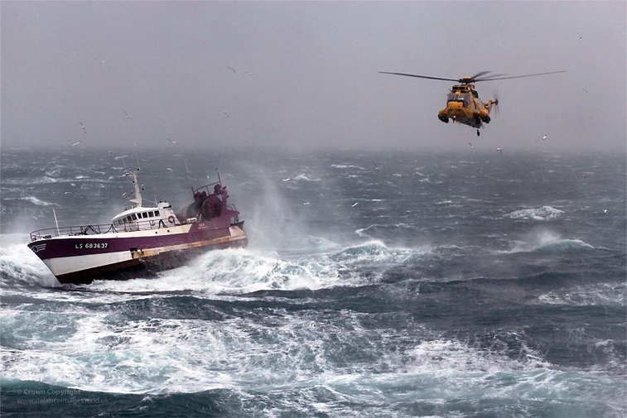
Inference
Why is the helicopter flying towards the boat?
Who do you think is in the helicopter?
How might the people on the boat be feeling?
What impact is the weather having on this scene?
Photo courtesy of Defence Images (@flickr.com) - granted under creative commons licence - attribution

Slide 12
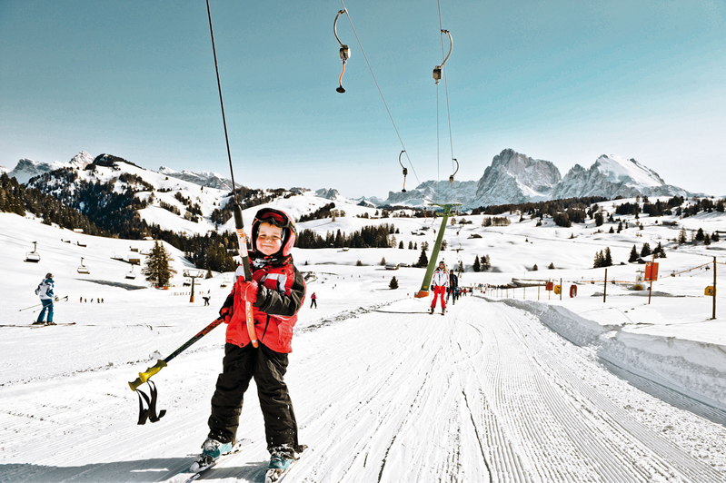
Inference
What is this child doing?
Do you think he has done this before?
Is this child at home or on holiday?
Why is he wearing warm clothes?
Photo courtesy of zumturm (@flickr.com) - granted under creative commons licence - attribution

Slide 13
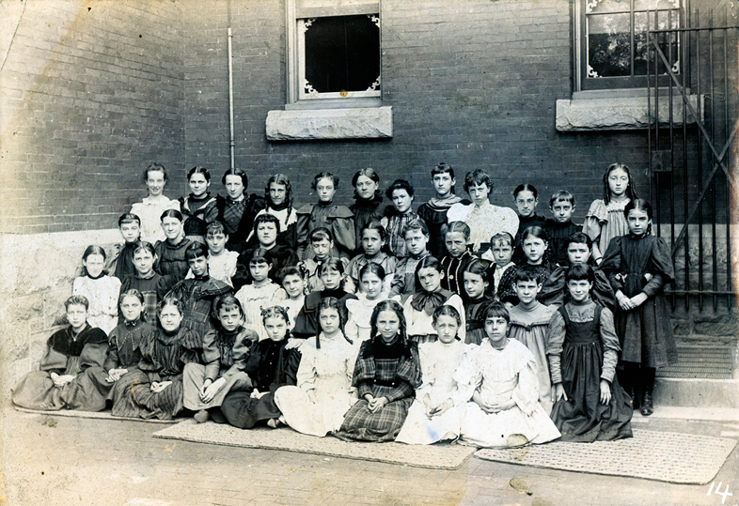
Inference
Is this photograph modern?
Where do you think these children are?
How do they feel about being there?
Photo courtesy of rich701 (@flickr.com) - granted under creative commons licence - attribution

Slide 14
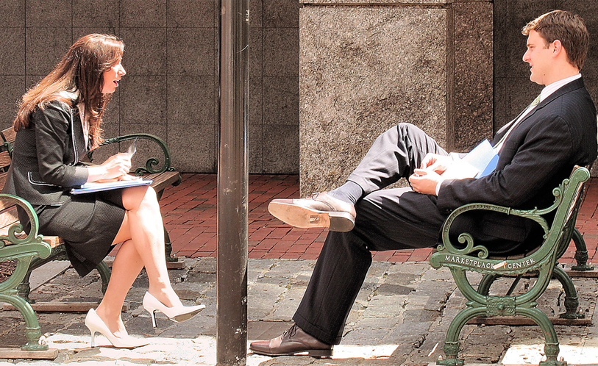
Inference
What do you think these people are talking about?
Are they both feeling the same way?
Which person is the most relaxed?
How can you tell?
Photo courtesy of Sharon Mollerus (@flickr.com) - granted under creative commons licence - attribution

Slide 15
Inference
If you see someone with a cast on their leg, can you infer that:
...they will have a cast on their arm too?
...they broke their leg?
...they injured themselves playing sport?
...they must wear the cast for six months?

Slide 16
Inference
If your teacher is not at school today, can you infer that:
…your teacher is never going to return?
…there will be no lessons at school today?
…you will not be given any homework?
…your teacher is sick or at a meeting?

Slide 17
Inference
Can you read the sentence below and find the correct inference?
Can you infer that:
…Tom’s car was a Rolls Royce?
…someone had cleaned Tom’s car as a surprise?
…Tom’s car was red?
…Tom had never cleaned his car before?
Tom couldn’t believe his eyes! His car was cleaner than he had ever seen it!

Slide 18
Inference
Can you read the sentence below and find the correct inference?
Can you infer that:
…the children were bored?
…it was winter time?
…the children loved fireworks?
…it was the first time the children had seen fireworks?
Boom! Fizz! Another one exploded over the children’s heads as they grinned and yelled in excitement.

Slide 19
Inference
Can you read the following passage and answer the questions?
Why did the baby throw the vegetables onto the floor?
Why did mum shout at the dog?
How did the baby feel when the vegetables were licked off the floor?
How do you know?
My baby sister picked up her vegetables and – one by one – threw them off her highchair and onto the floor. She kicked out her legs and giggled as they were quickly licked off the floor. When Mum came back into the room, she shouted at the dog to go away.

Slide 20
Inference
Can you read the following passage and answer the questions?
What was Will trying to get to work? How do you know?
How did Will feel when the screen went black?
How long do you think Will had been sitting there?
What might Will have been doing before this happened?
Will sighed and clicked the mouse again. It still wasn’t working. Then suddenly the screen went black. “Oh no!” wailed Will. “It’s all gone! I haven’t got time to start again!”

Slide 21
Inference
Can you read the following passage and answer the questions?
What did Maisie see outside her bedroom window?
Why was she going to have porridge for breakfast?
How did Maisie feel about there being no school today?
When Maisie drew her curtains that morning, she smiled and wrapped her arms around herself. There would be no school today, that’s for sure. She would get wrapped up and dig her sledge out of the garage. Then she would spend the rest of the day wrapped in a blanket. “Porridge for breakfast, I think!” she said.

Slide 22
Inference
Can you read the following passage and answer the questions?
How did the writer feel when the post arrived?
Was the writer expecting this letter?
How do you know the letter is important?
The letter box banged and I ran quickly to the door. With shaking hands, I slowly picked up the letters off the floor. A bill. A postcard. And then finally the letter I had been waiting for. I stared at the heavy cream envelope and the handwritten address. I hoped for good news.

Slide 23
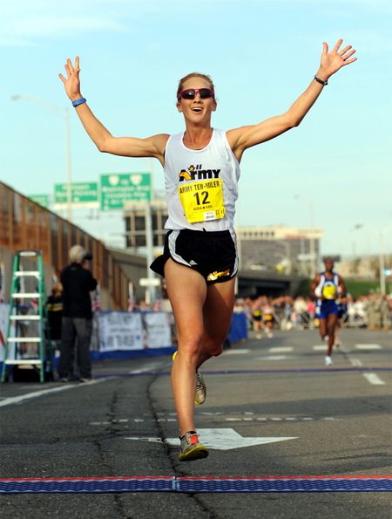
Inference
What can you infer from this picture?
What makes you think that?
Photo courtesy of familymwr (@flickr.com) - granted under creative commons licence - attribution

Slide 24
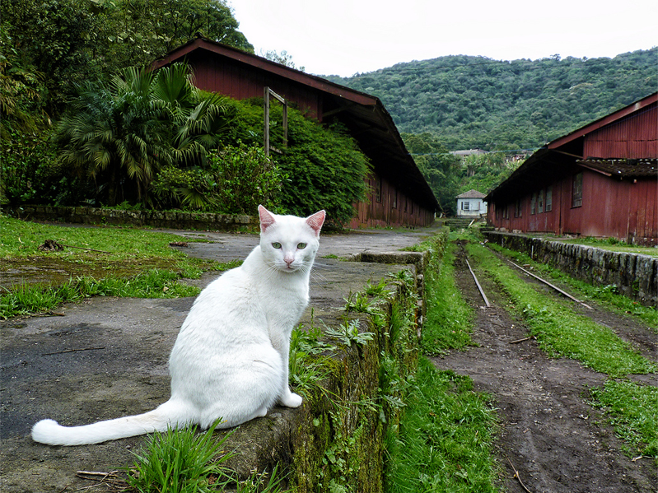
Inference
What can you infer from this picture?
What makes you think that?
Photo courtesy of Diego3336 (@flickr.com) - granted under creative commons licence - attribution

Slide 25
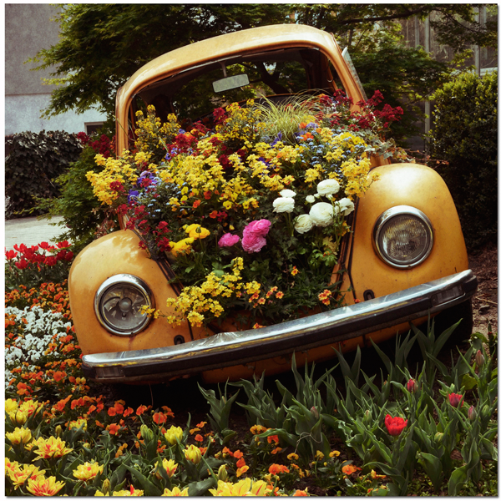
Inference
What can you infer from this picture?
What makes you think that?
Photo courtesy of pixel_unikat (@flickr.com) - granted under creative commons licence - attribution

Slide 26
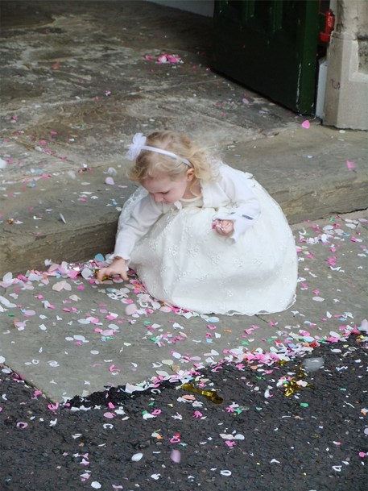
Inference
What can you infer from this picture?
What makes you think that?
Photo courtesy of Lee J Haywood (@flickr.com) - granted under creative commons licence - attribution

Slide 27
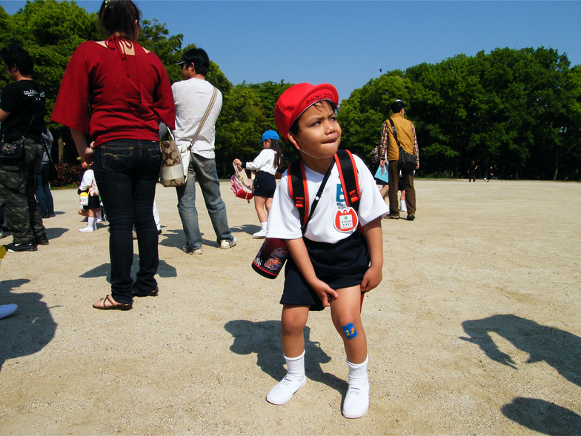
Inference
What can you infer from this picture?
What makes you think that?
Photo courtesy of emrank (@flickr.com) - granted under creative commons licence - attribution

Slide 28
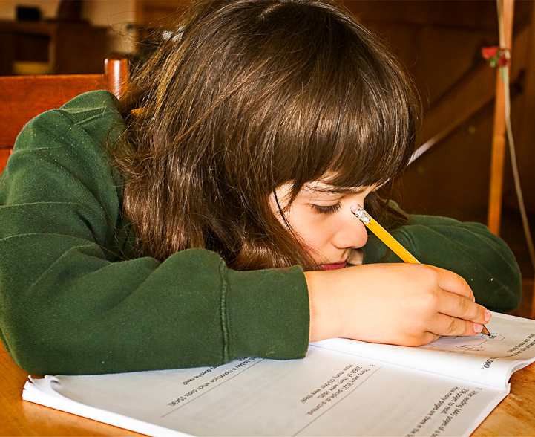
Inference
What can you infer from this picture?
What makes you think that?
Photo courtesy of chefranden (@flickr.com) - granted under creative commons licence - attribution

Slide 29
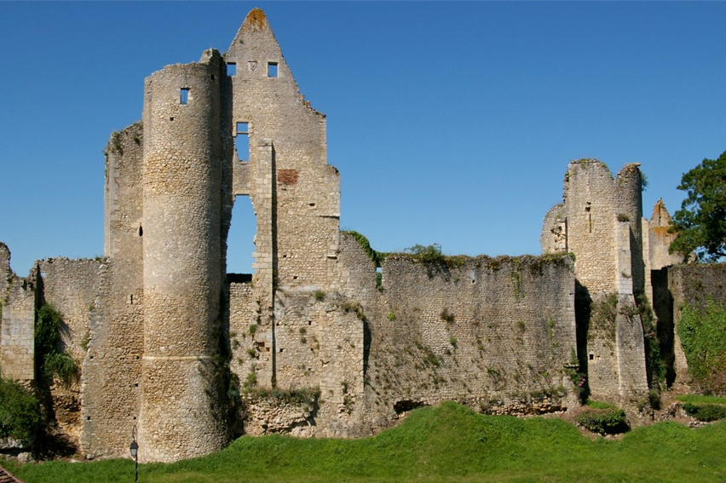
Inference
What can you infer from this picture?
What makes you think that?
Photo courtesy of sybarite48 (@flickr.com) - granted under creative commons licence - attribution

Slide 30
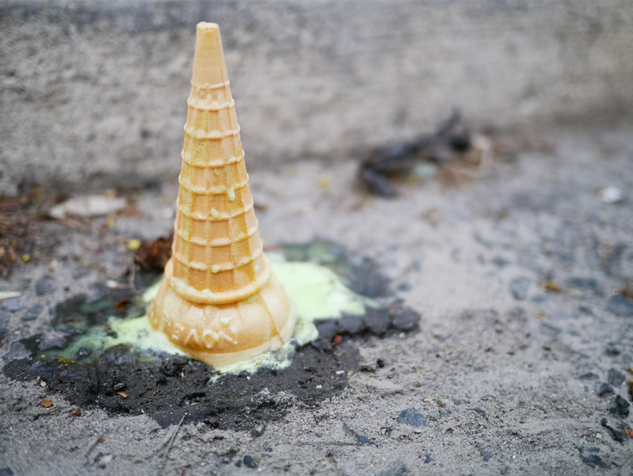
Inference
What can you infer from this picture?
What makes you think that?
Photo courtesy of Johnath (@flickr.com) - granted under creative commons licence - attribution

